Slide 1
Introduction To PHP

Slide 2
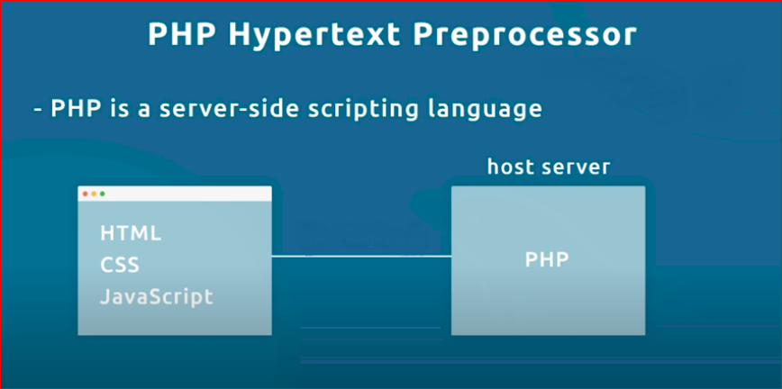

Slide 3
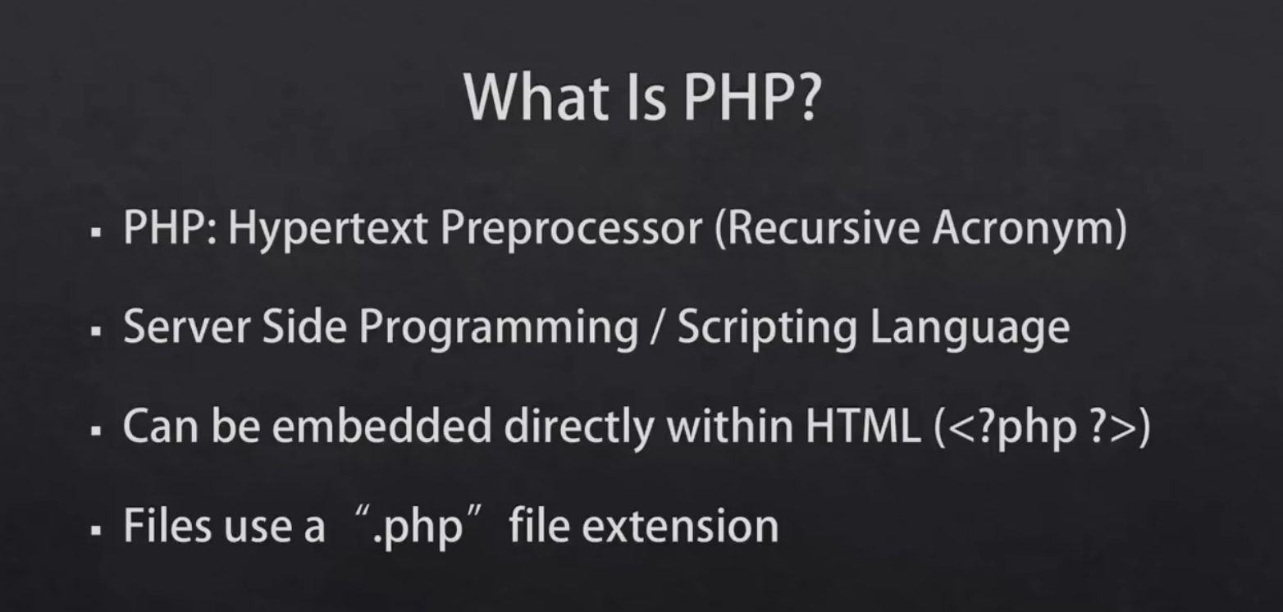

Slide 4
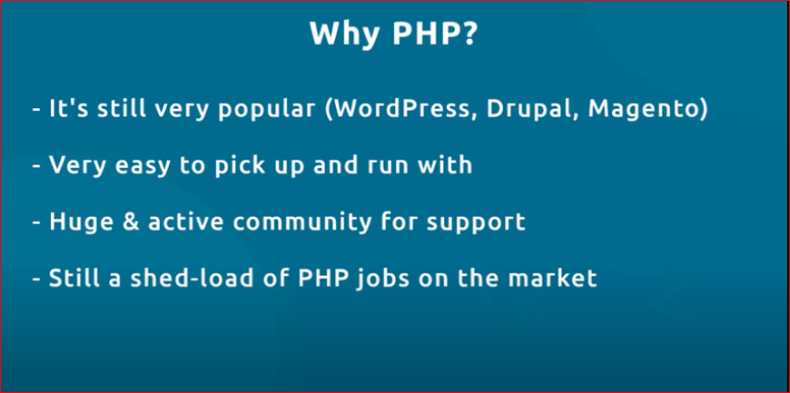

Slide 5
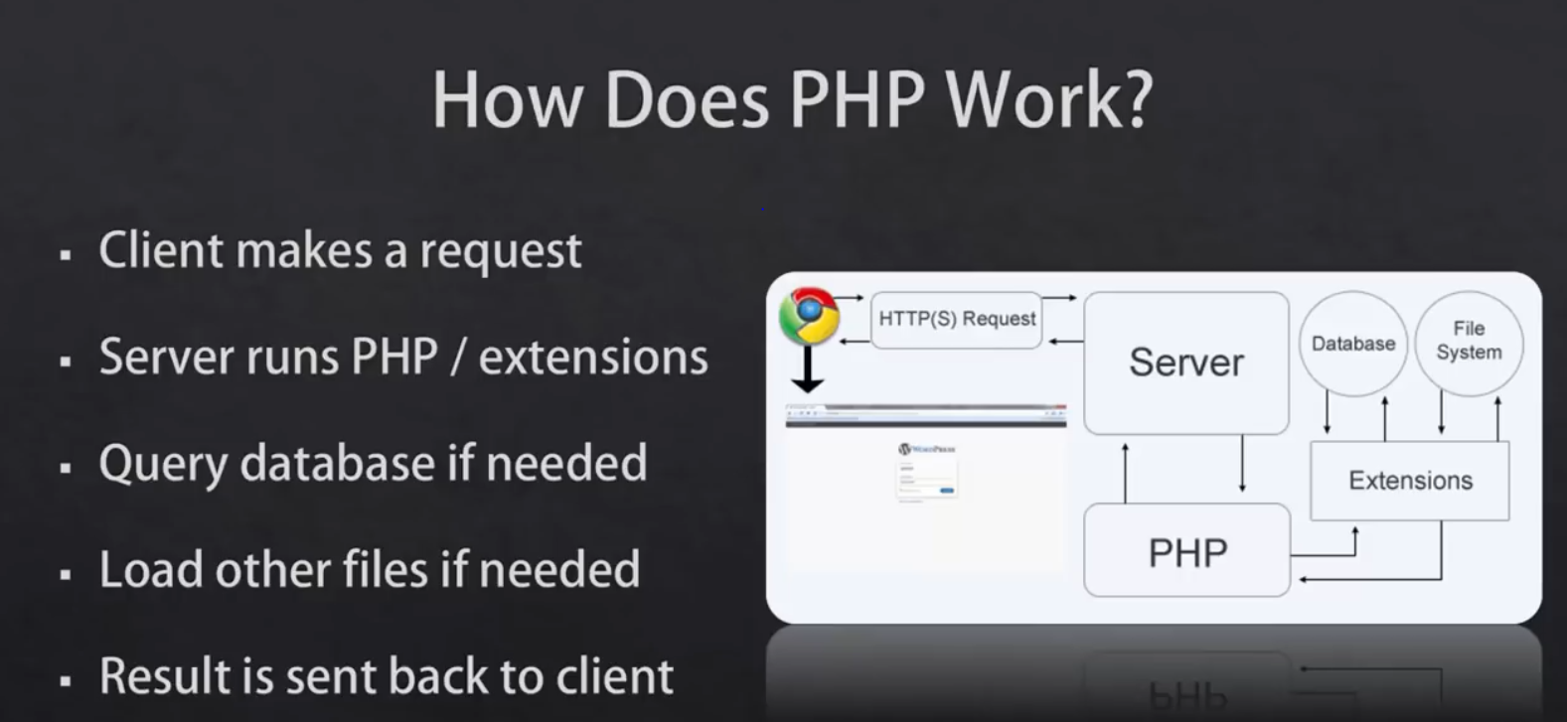
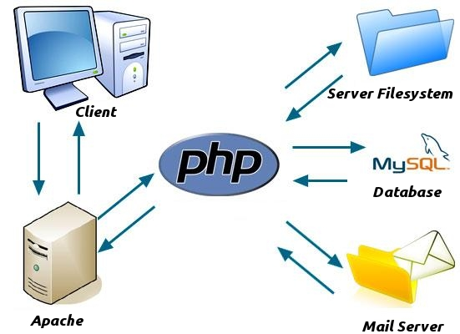

Slide 6
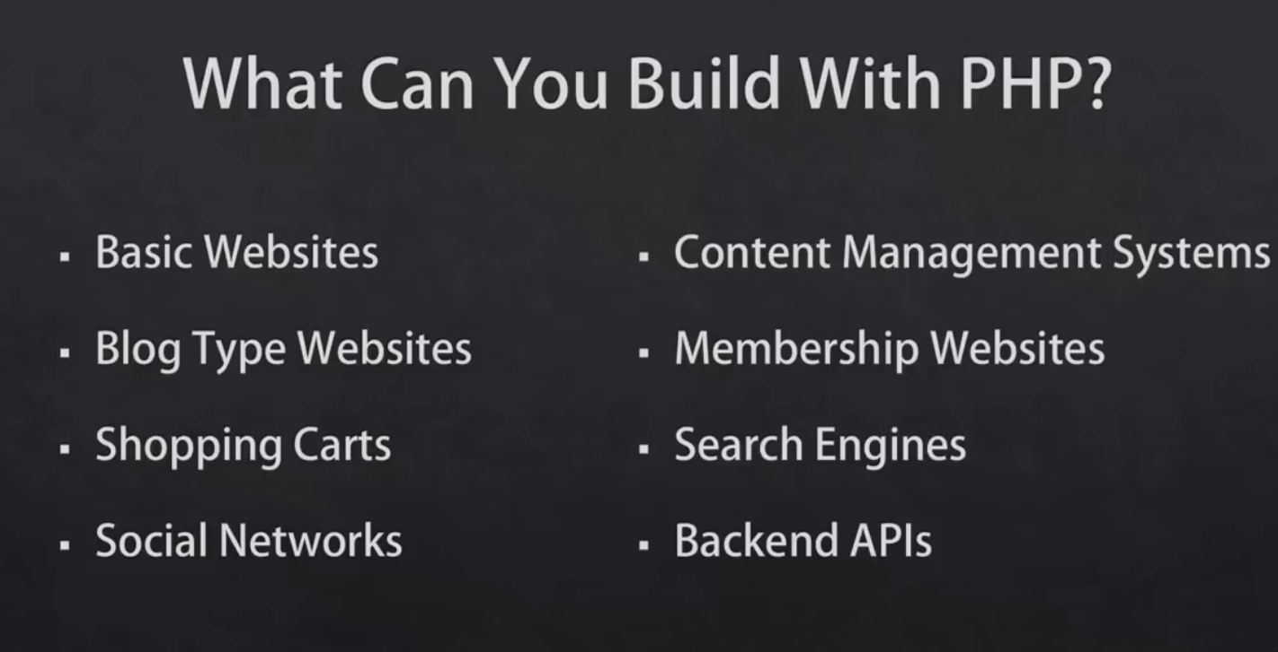

Slide 7
Context:
Installing
PHP / Apache / MySQL Setup
PHP basics Principles
Code Syntax (vars, arrays, loops, conditionals, functions)
Database (sql vs no sql) (new module)
Sql (new module)
Dynamics Pages (back to PHP)
PHP Forms (CRUD)
Working with Databases
Project (New module)

Slide 8
We will use
2 Layer architecture
Mysqli db connection

Slide 9
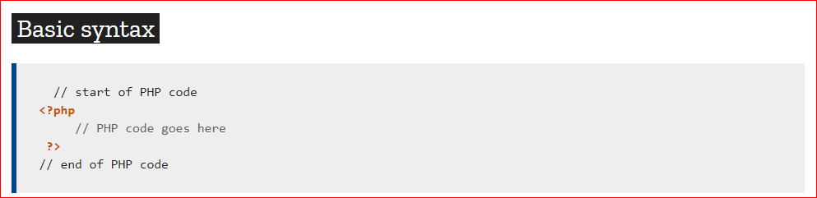

Slide 10
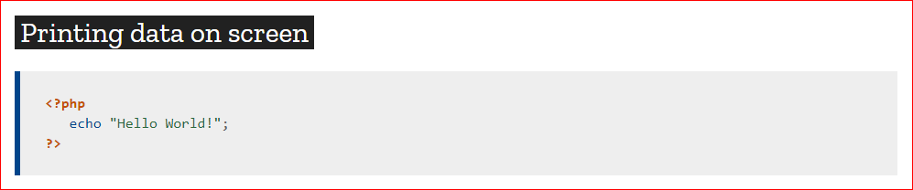

Slide 11
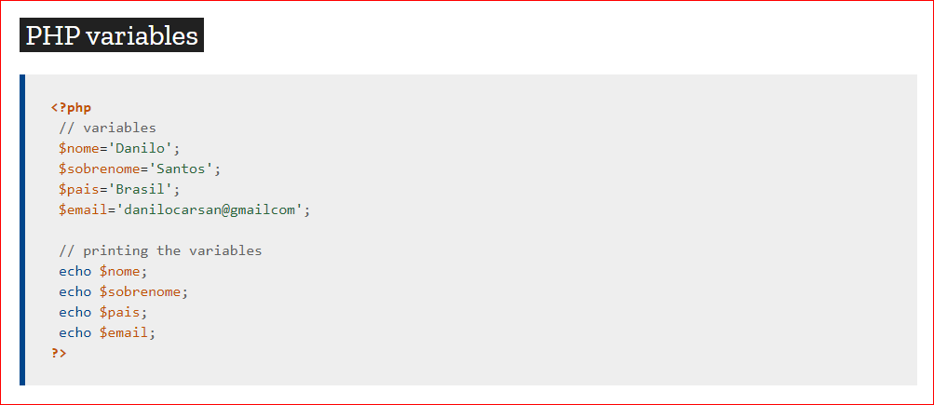

Slide 12
After PHP
OOPs(Object oriented Programming) PHP
3layer architecture
PDO (PHP data types) database connection
Laravel

